Slide 1
Intro to Linux Commands

Slide 2
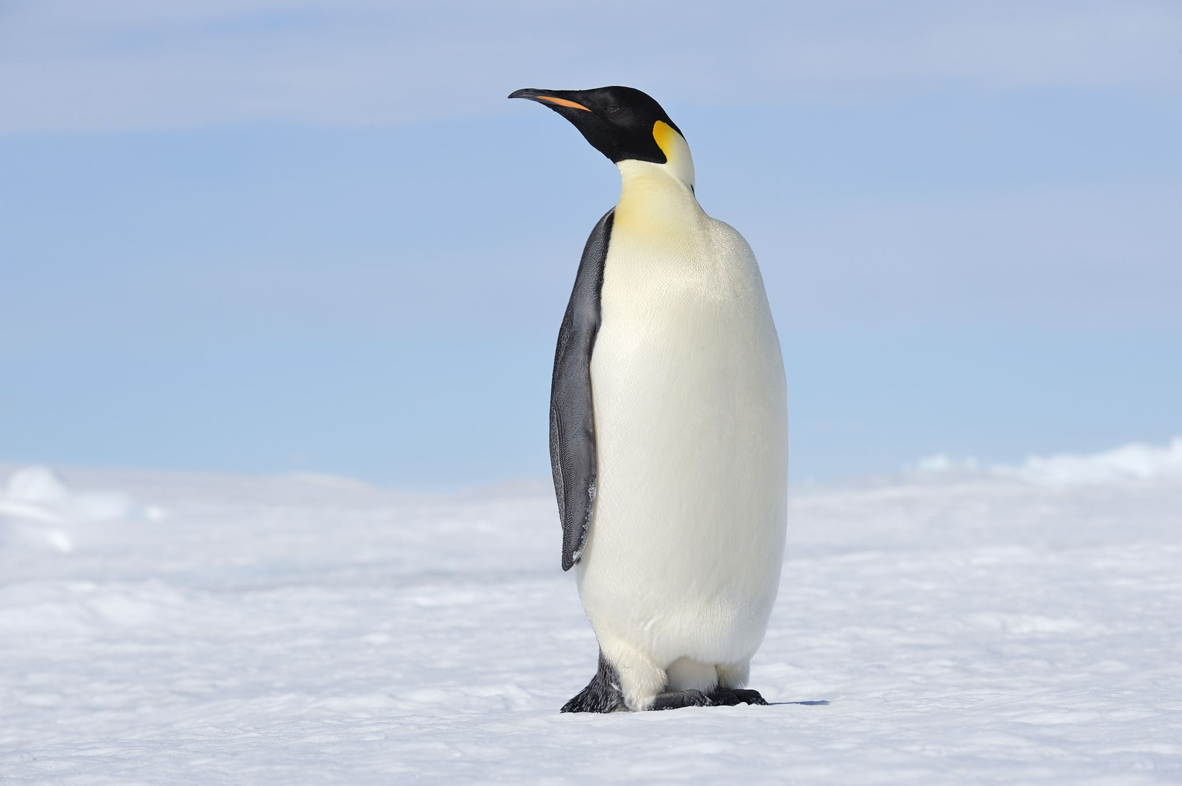
Outline
Getting Linux
Navigating Linux
Doing things in Linux
Looking at bioinformatics files (fastq, etc)
Intro to Homework
Many ideas taken from http://korflab.ucdavis.edu/bootcamp.html

Slide 3



Getting Linux - downloading yourself (windows)
VisualStudio Code (VSCode)
https://code.visualstudio.com/
Windows Subsystem for Linux
https://apps.microsoft.com/store/detail/windows-subsystem-for-linux/9P9TQF7MRM4R
Installation instructions:
https://code.visualstudio.com/docs/remote/wsl
√
(NOT VisualStudio)

Slide 4
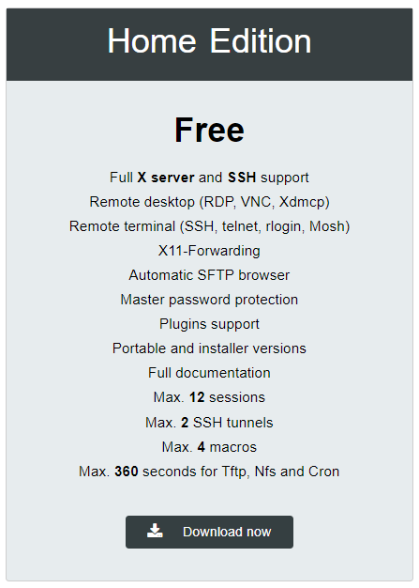

Getting Linux - downloading yourself (windows) (alternative)
MobaXTerm
https://mobaxterm.mobatek.net/download.html
Current version (Spring 2023, v23.0)
Windows Subsystem for Linux
https://apps.microsoft.com/store/detail/windows-subsystem-for-linux/9P9TQF7MRM4R

Slide 5



Getting Linux - MacOS
Open the program terminal
https://support.apple.com/guide/terminal/open-or-quit-terminal-apd5265185d-f365-44cb-8b09-71a064a42125/mac.
Alternatively, install VSCode
https://code.visualstudio.com/
Open Terminal
On your Mac, do one of the following:
Click the Launchpad icon in the Dock, type Terminal in the search field, then click Terminal.
In the Finder , open the /Applications/Utilities folder, then double-click Terminal.

Slide 6
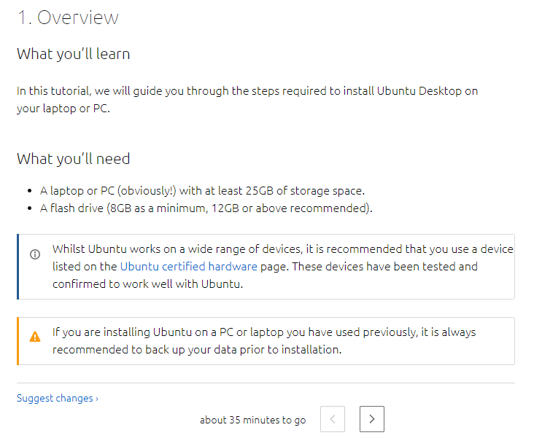


Getting Linux - downloading yourself (replace your operating system - not preferred)
Ubuntu if you’re new to Linux
https://ubuntu.com/tutorials/install-ubuntu-desktop#1-overview

Slide 7

Navigating Linux
Pause here so that you can get Linux

Slide 8
http://korflab.ucdavis.edu/bootcamp.html
This is a good resource. We will cover most (but not all) of what is there.

Slide 9
Why command line; specifically linux/unix
Navigating files
Repeated operations on many files with a single command.
Many many many bioinformatics tools have a command line interface (CLI). Many are designed for running on linux…most computing clusters are running linux.
Assumptions
You have access to a Linux system (Snowball or Ubuntu)
You have the terminal 💻
You have a home directory

Slide 10
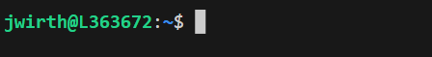
The command prompt
Executes exactly what you tell it to do. It will not intuit your meaning.
Returns any values on the next line

Slide 11
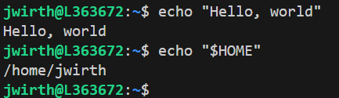
Basic commands: echo
Repeats text
echo "Hello, world"
Unveils the contents of variables
echo "$HOME"

Slide 12
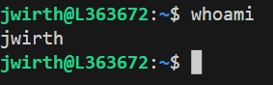
Basic commands: whoami
Tells you your user name

Slide 13

“Where am I?” pwd
Notes:
Need to explain what where means

Slide 14
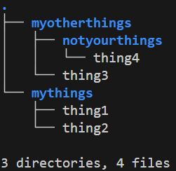
What does “where” mean?
No matter where you are, you are always at .
You have a location relative to the root of the file system; the “absolute” path
You have a location relative to the current folder you are in; the “relative” path
Notes:
http://korflab.ucdavis.edu/bootcamp.html

Slide 15
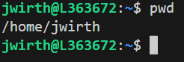
“Where am I?” pwd
print working directory
This tells you where you are using the absolute path
Notice that it starts with /
This tells us how to get there from the root of the file system … it will be true in any other location
Notes:
http://korflab.ucdavis.edu/bootcamp.html

Slide 16
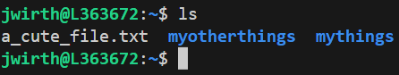
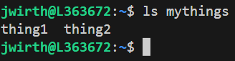
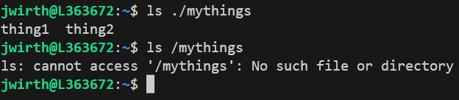
“What is here?” ls
list
This tells you which files are in here with you.
Alternatively, you can specify a directory to examine (rel or abs)
Notes:
http://korflab.ucdavis.edu/bootcamp.html

Slide 17
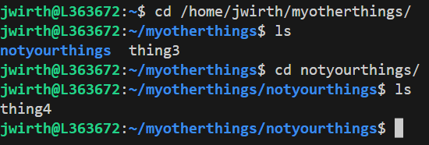
Moving around a file system cd
change directory
This lets you move from one directory to another
Can specify relative or absolute paths (just like ls)
Notes:
http://korflab.ucdavis.edu/bootcamp.html

Slide 18
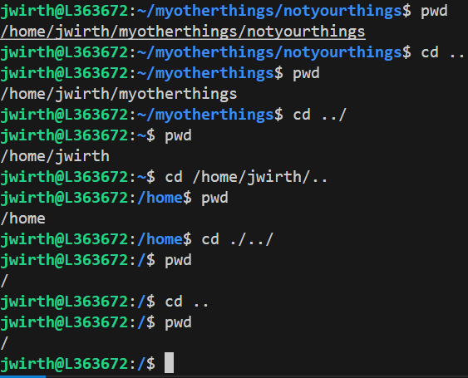
cd ../
change directory
..
The parental directory
Notes:
http://korflab.ucdavis.edu/bootcamp.html

Slide 19
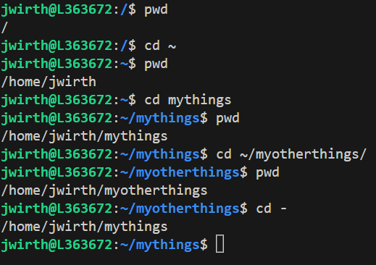
cd ~ and cd -
~ is where the heart is
change directory
..
The parental directory
~
Your home directory ($HOME)
-
The previous directory you were in.
Notes:
http://korflab.ucdavis.edu/bootcamp.html

Slide 20


A note: TAB auto-complete. Do it.
demo
Notes:
http://korflab.ucdavis.edu/bootcamp.html

Slide 21
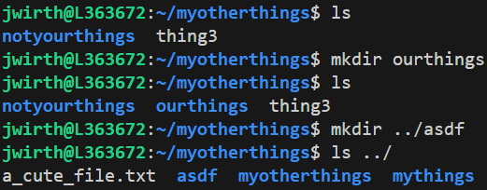
Making a new directory mkdir
make directory
Notes:
http://korflab.ucdavis.edu/bootcamp.html

Slide 22
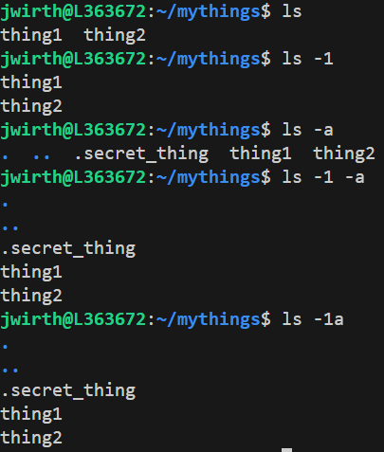
Flags
Flags can be used to change the functionality of a program.
They typically start with -
3
Notes:
http://korflab.ucdavis.edu/bootcamp.html

Slide 23
Getting help man
manual pages
Press q to quit
demo
Notes:
http://korflab.ucdavis.edu/bootcamp.html

Slide 24
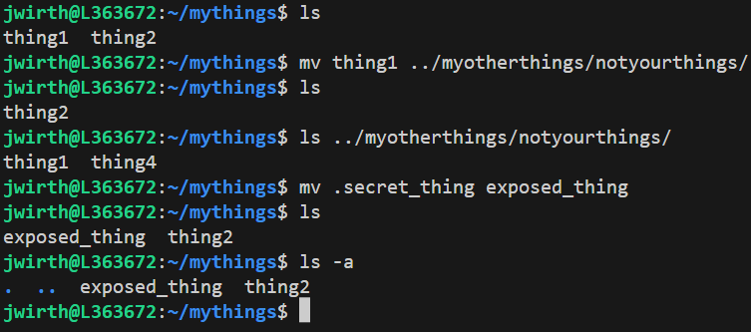
Moving or renaming files mv
move
Notes:
http://korflab.ucdavis.edu/bootcamp.html

Slide 25
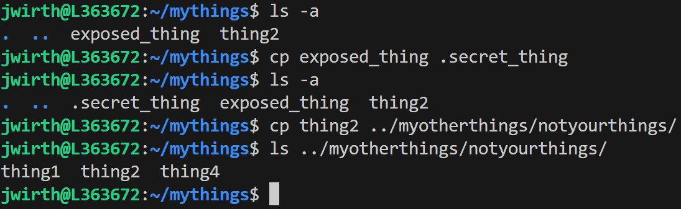
Copying files cp
copy
Notes:
http://korflab.ucdavis.edu/bootcamp.html

Slide 26
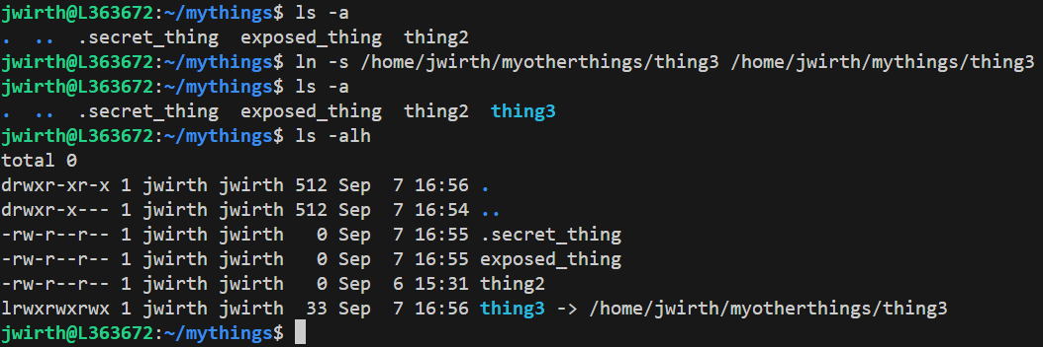
Symbolic links ln -s
link
Notes:
http://korflab.ucdavis.edu/bootcamp.html

Slide 27
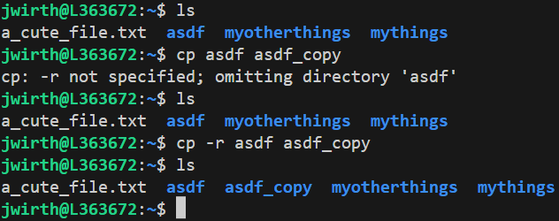
Copying directories cp -r
copy
Notes:
http://korflab.ucdavis.edu/bootcamp.html

Slide 28

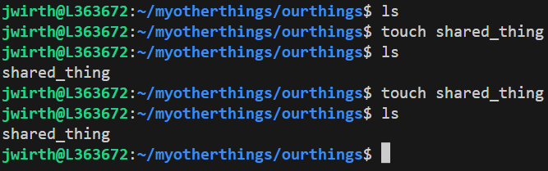
Making an empty file touch
Notes:
http://korflab.ucdavis.edu/bootcamp.html

Slide 29
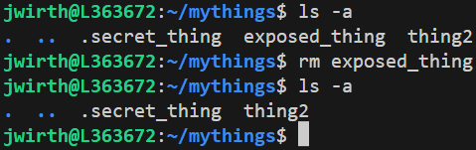
Removing files rm
remove
DANGER! THIS CANNOT BE UNDONE!
Notes:
nano shared_thing

Slide 30
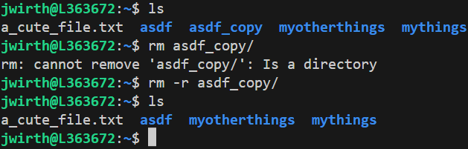
Removing folders rm -r
remove
DANGER! THIS CANNOT BE UNDONE!
Notes:
nano shared_thing

Slide 31
Editing files nano
Press ctrl+x to quit
demo
Notes:
nano shared_thing

Slide 32
Viewing file contents less
Press q to quit
demo
Notes:
nano shared_thing

Slide 33
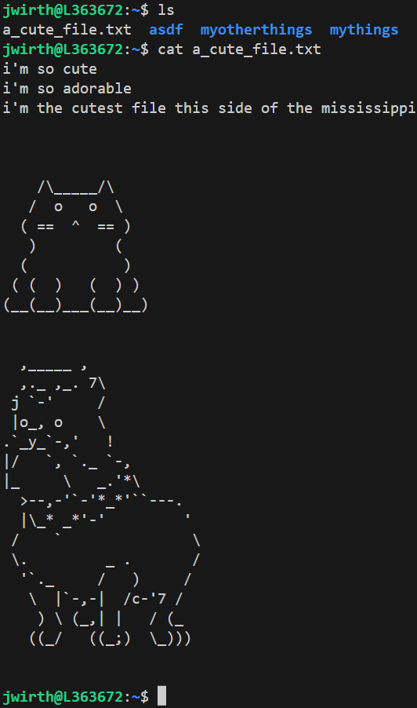
viewing file contents cat
concatenate
output == file contents
Notes:
nano shared_thing

Slide 34
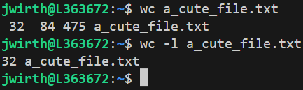
counting file contents wc
word count
Default: lines, words, characters
Notes:
Lines, words, chacters

Slide 35
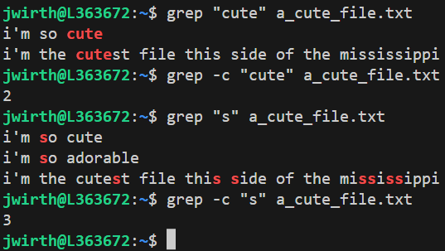
Searching files grep
global regular expression search and print
We will not discuss regular expressions in this class, but they allow pattern matching
We will only search the “normal” way

Slide 36
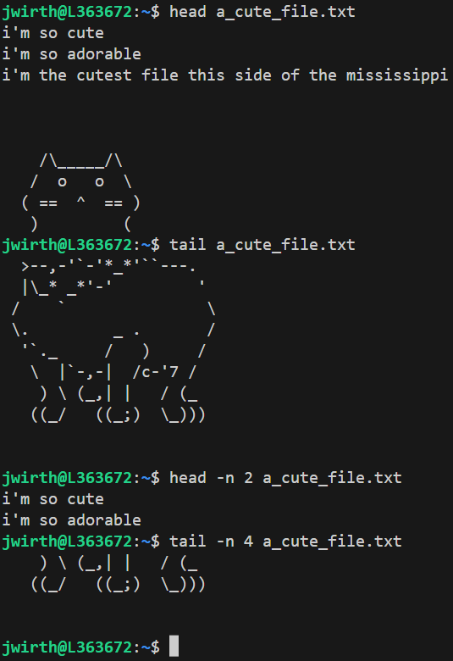
See the top/bottom of files head tail

Slide 37
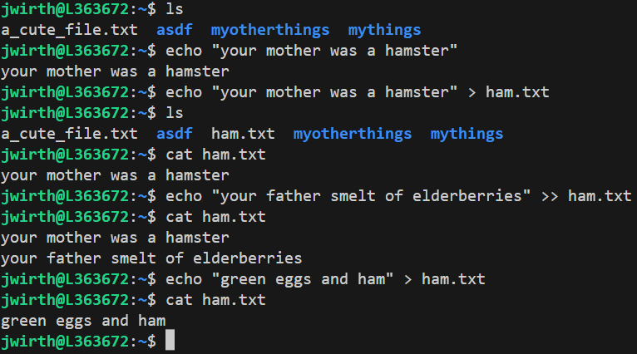
Redirection to save output > >>
>
write to file
>>
Append to file

Slide 38
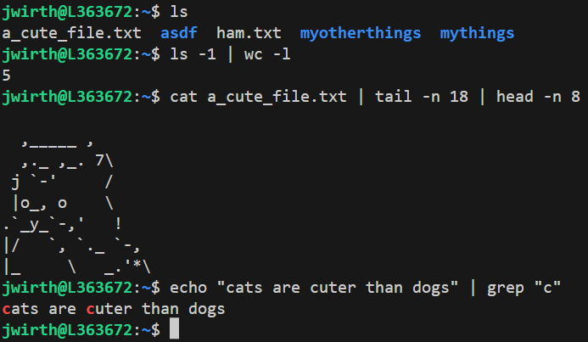
Redirection to combine commands |

Slide 39
Looking at bioinformatics files
Download the SARS-CoV-2 reference genome Wuhan-1
LOCUS NC_045512 29903 bp ss-RNA linear VRL 18-JUL-2020
DEFINITION Severe acute respiratory syndrome coronavirus 2 isolate Wuhan-Hu-1,
complete genome.
ACCESSION NC_045512
VERSION NC_045512.2
DBLINK BioProject: PRJNA485481
KEYWORDS RefSeq.
SOURCE Severe acute respiratory syndrome coronavirus 2 (SARS-CoV-2)
ORGANISM Severe acute respiratory syndrome coronavirus 2
Viruses; Riboviria; Orthornavirae; Pisuviricota; Pisoniviricetes;
Nidovirales; Cornidovirineae; Coronaviridae; Orthocoronavirinae;
Betacoronavirus; Sarbecovirus.
REFERENCE 1 (bases 1 to 29903)
AUTHORS Wu,F., Zhao,S., Yu,B., Chen,Y.M., Wang,W., Song,Z.G., Hu,Y.,
Tao,Z.W., Tian,J.H., Pei,Y.Y., Yuan,M.L., Zhang,Y.L., Dai,F.H.,
Liu,Y., Wang,Q.M., Zheng,J.J., Xu,L., Holmes,E.C. and Zhang,Y.Z.
TITLE A new coronavirus associated with human respiratory disease in
China
JOURNAL Nature 579 (7798), 265-269 (2020)
PUBMED 32015508
REMARK Erratum:[Nature. 2020 Apr;580(7803):E7. PMID: 32296181]
REFERENCE 2 (bases 13476 to 13503)
AUTHORS Baranov,P.V., Henderson,C.M., Anderson,C.B., Gesteland,R.F.,
Atkins,J.F. and Howard,M.T.
TITLE Programmed ribosomal frameshifting in decoding the SARS-CoV genome
JOURNAL Virology 332 (2), 498-510 (2005)
PUBMED 15680415
REFERENCE 3 (bases 29728 to 29768)
AUTHORS Robertson,M.P., Igel,H., Baertsch,R., Haussler,D., Ares,M. Jr. and
Scott,W.G.
TITLE The structure of a rigorously conserved RNA element within the SARS
virus genome
JOURNAL PLoS Biol. 3 (1), e5 (2005)
PUBMED 15630477
REFERENCE 4 (bases 29609 to 29657)
AUTHORS Williams,G.D., Chang,R.Y. and Brian,D.A.
TITLE A phylogenetically conserved hairpin-type 3' untranslated region
pseudoknot functions in coronavirus RNA replication
JOURNAL J. Virol. 73 (10), 8349-8355 (1999)
PUBMED 10482585
REFERENCE 5 (bases 1 to 29903)
CONSRTM NCBI Genome Project
TITLE Direct Submission
curl 'https://www.ncbi.nlm.nih.gov/sviewer/viewer.cgi?tool=portal&save=file&log$=seqview&db=nuccore&report=genbank&id=1798174254&conwithfeat=on&withparts=on&hid
e-cdd=on’ > wuhan-1.gbk
less wuhan-1.gbk

Slide 40
Some file operations
How many contigs are there?
grep -c LOCUS wuhan-1.gbk
How many genes are there and where are they?
grep ' gene ' wuhan-1.gbk
gene 266..21555
gene 21563..25384
gene 25393..26220
gene 26245..26472
gene 26523..27191
gene 27202..27387
gene 27394..27759
gene 27756..27887
gene 27894..28259
gene 28274..29533
gene 29558..29674
Did I remember to download the genbank file with sequence? Sometimes I forget that option.
$ tail wuhan-1.gbk
29461 tgctgcagat ttggatgatt tctccaaaca attgcaacaa tccatgagca gtgctgactc
29521 aactcaggcc taaactcatg cagaccacac aaggcagatg ggctatataa acgttttcgc
29581 ttttccgttt acgatatata gtctactctt gtgcagaatg aattctcgta actacatagc
29641 acaagtagat gtagttaact ttaatctcac atagcaatct ttaatcagtg tgtaacatta
29701 gggaggactt gaaagagcca ccacattttc accgaggcca cgcggagtac gatcgagtgt
29761 acagtgaaca atgctaggga gagctgccta tatggaagag ccctaatgtg taaaattaat
29821 tttagtagtg ctatccccat gtgattttaa tagcttctta ggagaatgac aaaaaaaaaa
29881 aaaaaaaaaa aaaaaaaaaa aaa
//
Yep there is a sequence here!

Slide 41
Interactive
What would you do to find the number of contigs in a fasta file?
grep -c ">" file.fasta
Be careful that the > is quoted
What would you do to make a backup of a file “contigs.gbk” into “contigs.gbk.bak”?
cp contigs.gbk contigs.gbk.bak
How would you remove the backup file?
rm contigs.gbk.bak

Slide 42

Introduction to the homework
Who likes a good text-only role playing game??

Slide 43
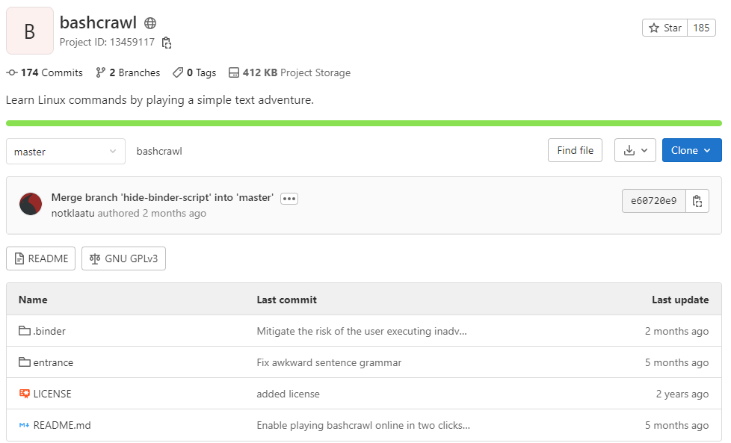
Bashcrawl: the homework
https://gitlab.com/slackermedia/bashcrawl

Slide 44
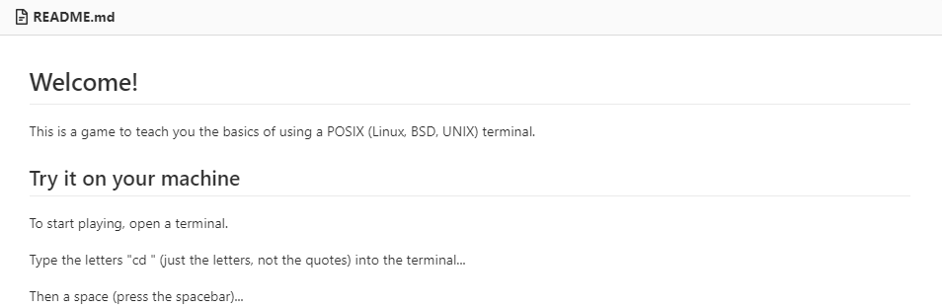
How to start
This whole thing is on the command line
Get the game with
curl https://gitlab.com/slackermedia/bashcrawl/-/archive/master/bashcrawl-master.zip
Follow the tutorial on the website

